Slide 1

Anomaly & Fraud Detection Credit card from customer’s factors
There is 1 Impostor among us

Slide 2
Table of Contents
01
02
03
04
EDA
Evaluation Model
Describe the factors Of Fraud & Not Fraud
Steps for management the data and evaluate the models
Result
Conclusion
Which models are the best for evaluation
Recommend and conclude the factors of Fraud data

Slide 3
Problem Statements
Which factors or behavior of fraudulent customer.
To classify and predict new transaction automatically.
Which models are the best efficient to predict fraud.

Slide 4
Size of data set
590,540 x 434
This data is brought from IEEE Computational Intelligence Society (IEEE-CIS) for detection of fraud and not fraud of credit card customer in Kaggle.

Slide 5
Explore the Data
No Fraud
Fraud !!
From the data, there are not fraud about 96.50%
Only 3.50% are fraud !

Slide 6
Data Description
Features | Description
TransactionDT | Timedelta from a given reference datetime
TransactionAMT | Transaction payment amount in USD
ProductCD | Product code, the product for each transaction
Card1 - Card6 | Payment card information, such as card type, card category, issue bank, country, etc.
Addr | Address
Dist | Distance
P_ and (R__) emaildomain | Purchaser and recipient email domain
C1-C14 | Counting, such as how many addresses are found to be associated with the payment card, etc. The actual meaning is masked.
D1-D15 | Timedelta, such as days between previous transaction, etc.
M1-M9 | Match, such as names on card and address, etc.
Vxxx | Vesta engineered rich features, including ranking, counting, and other entity relations.

Slide 7
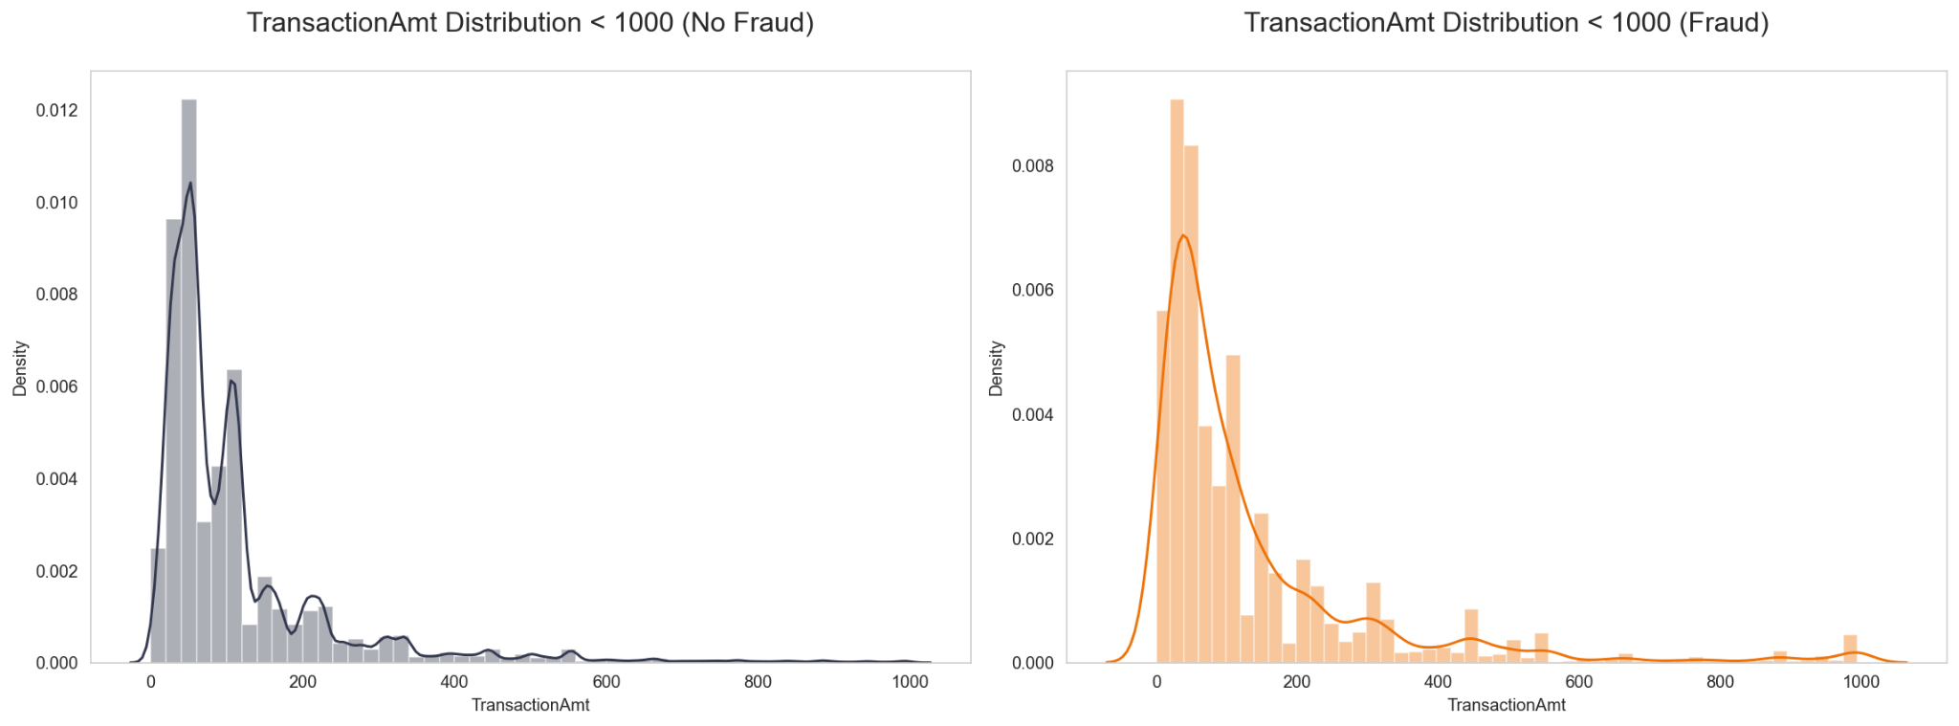
Distribution of the data
No Fraud
Fraud !!

Slide 8
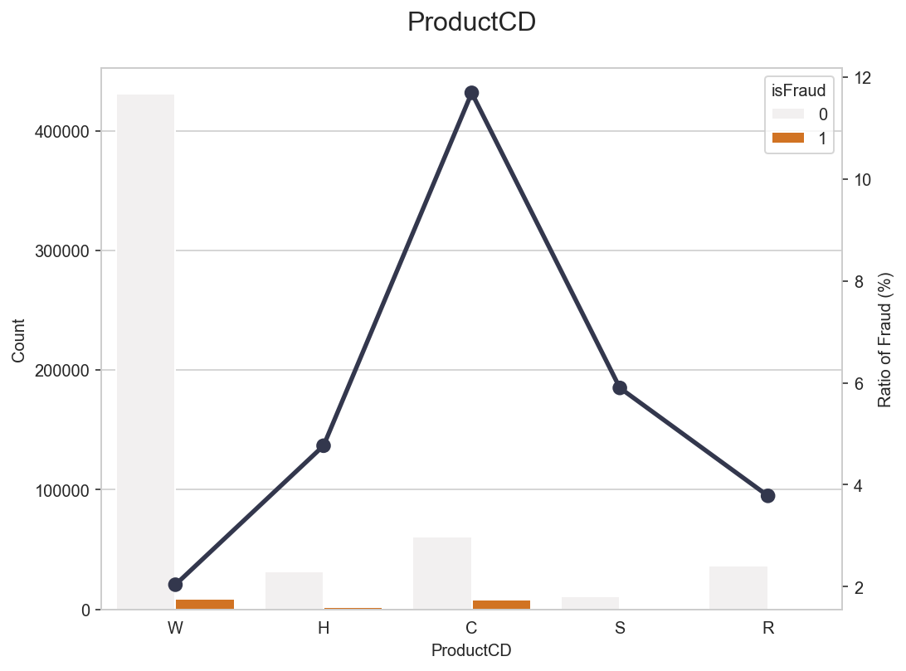
Explore the data (product cd)
Product C - Fraud: 11.68% - Not Fraud: 88.32%
Product S - Fraud: 5.90% - Not Fraud: 94.10%
Product H - Fraud: 4.77% - Not Fraud: 95.23%
Product W - Fraud: 2.04% - Not Fraud: 97.96%
Product R - Fraud: 3.78% - Not Fraud: 96.22%

Slide 9
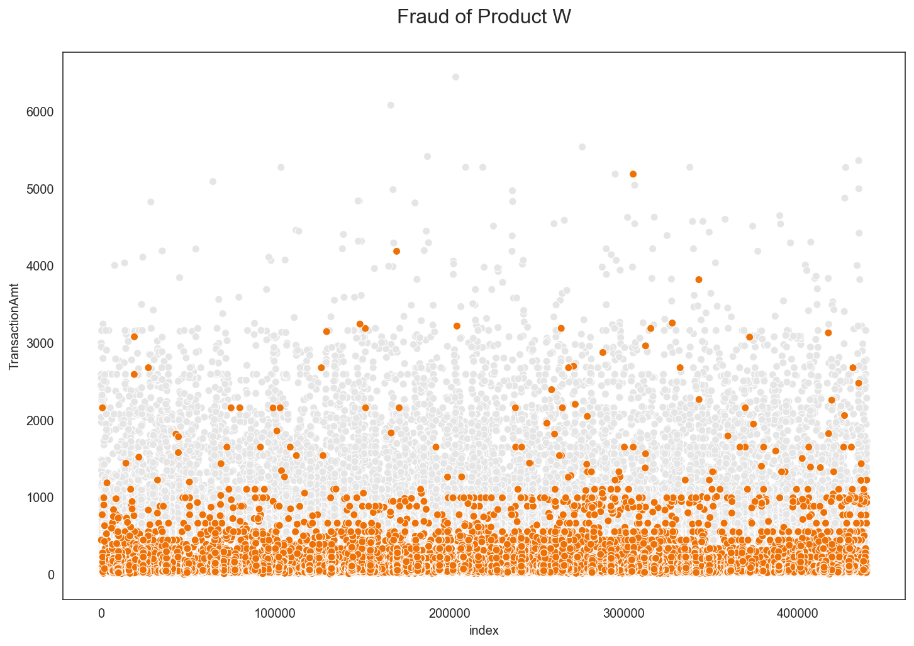

Slide 10
Explore the data (product cd)
Product C - Fraud: 11.68% - Not Fraud: 88.32%
Product S - Fraud: 5.90% - Not Fraud: 94.10%
Product H - Fraud: 4.77% - Not Fraud: 95.23%
Product W - Fraud: 2.04% - Not Fraud: 97.96%
Product R - Fraud: 3.78% - Not Fraud: 96.22%

Slide 11
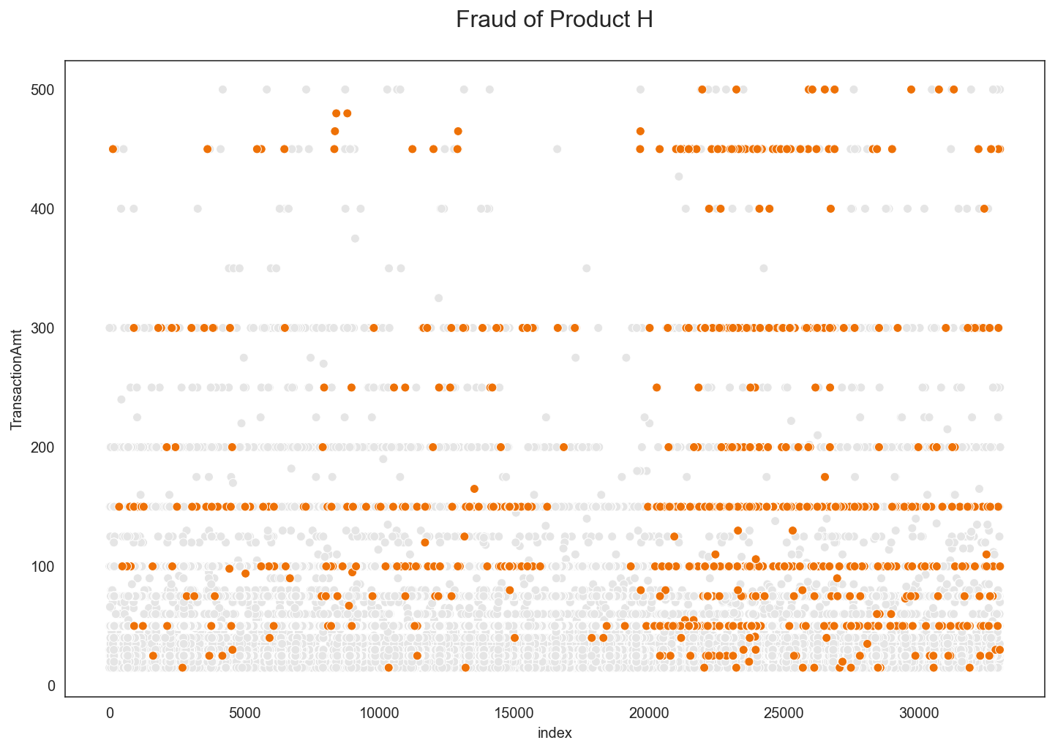

Slide 12
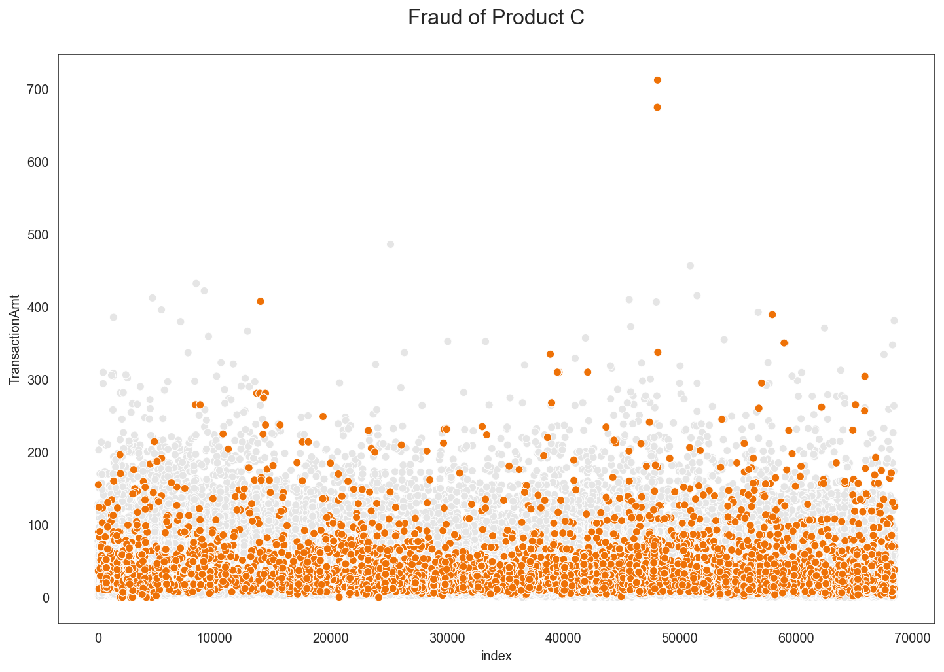

Slide 13
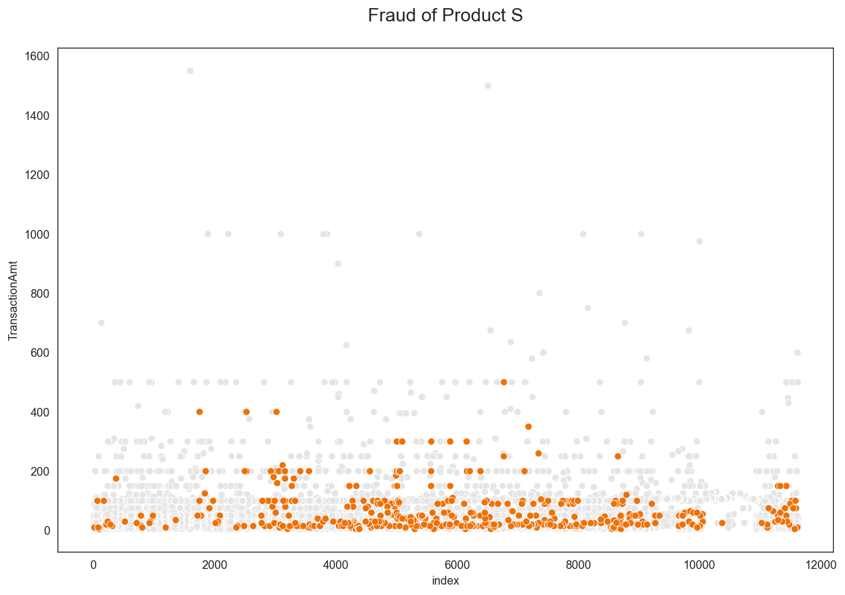

Slide 14
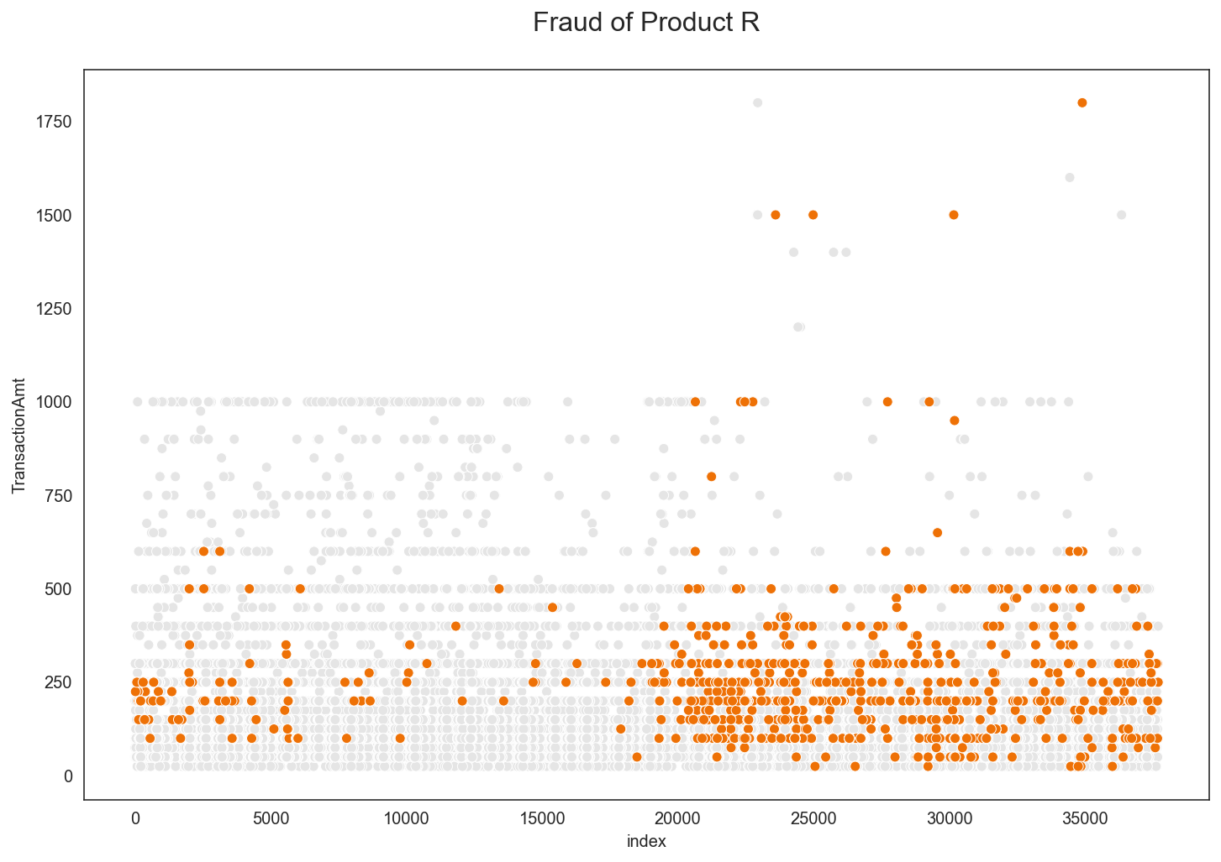

Slide 15
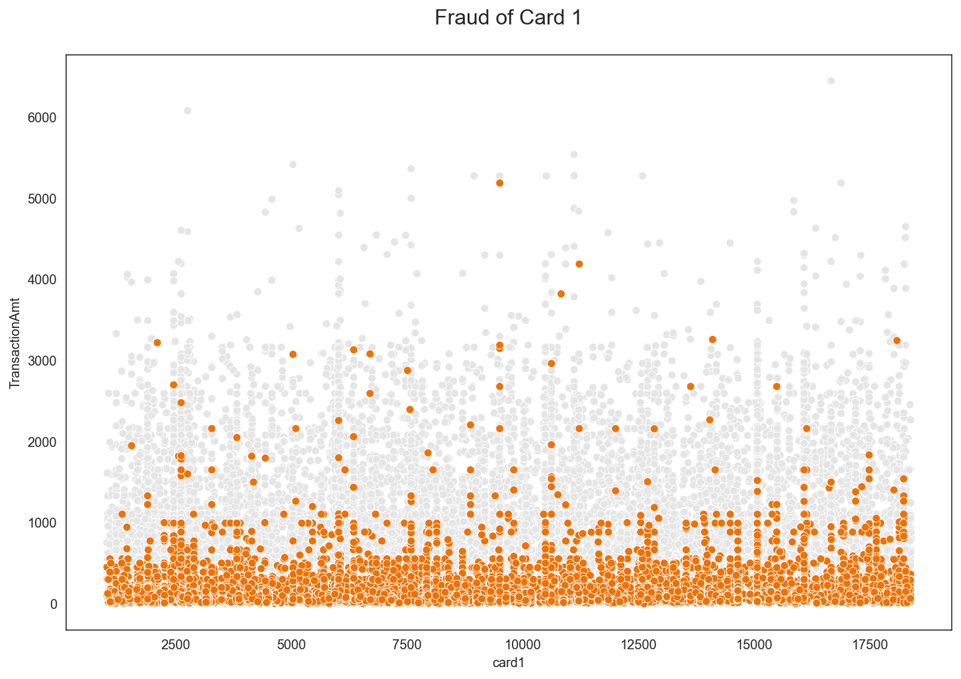
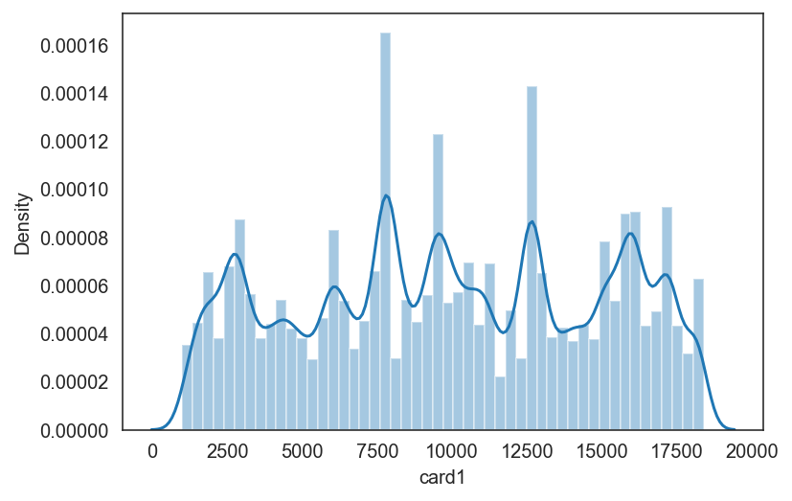
Explore the data (card 1-6)
Card 1

Slide 16
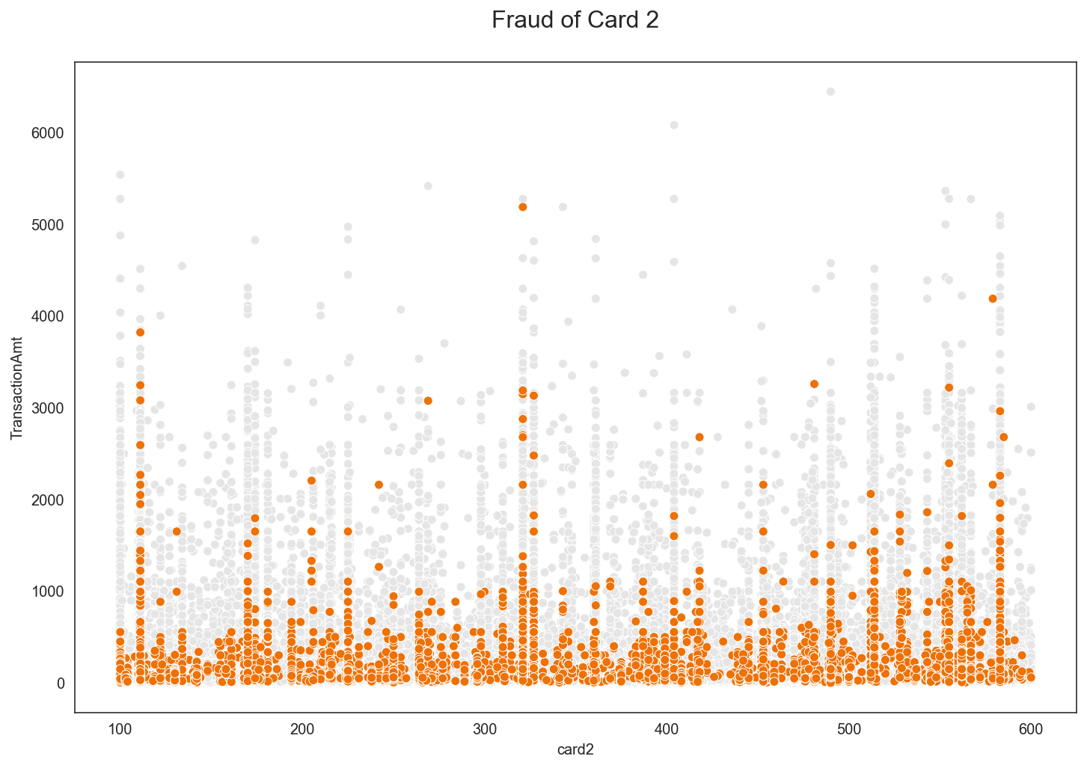
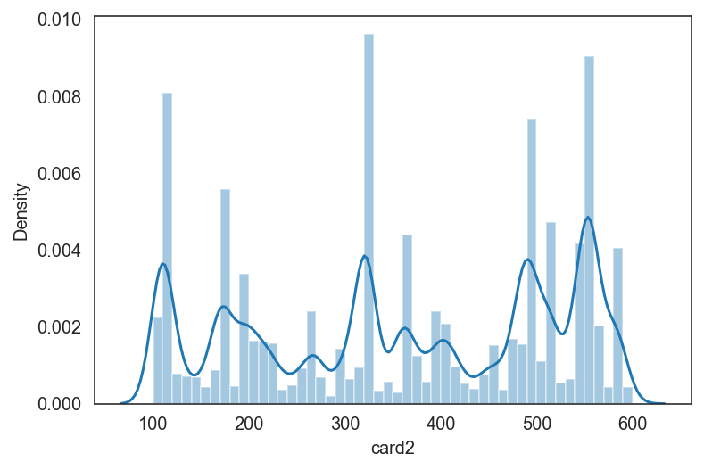
Explore the data (card 1-6)
Card 2

Slide 17
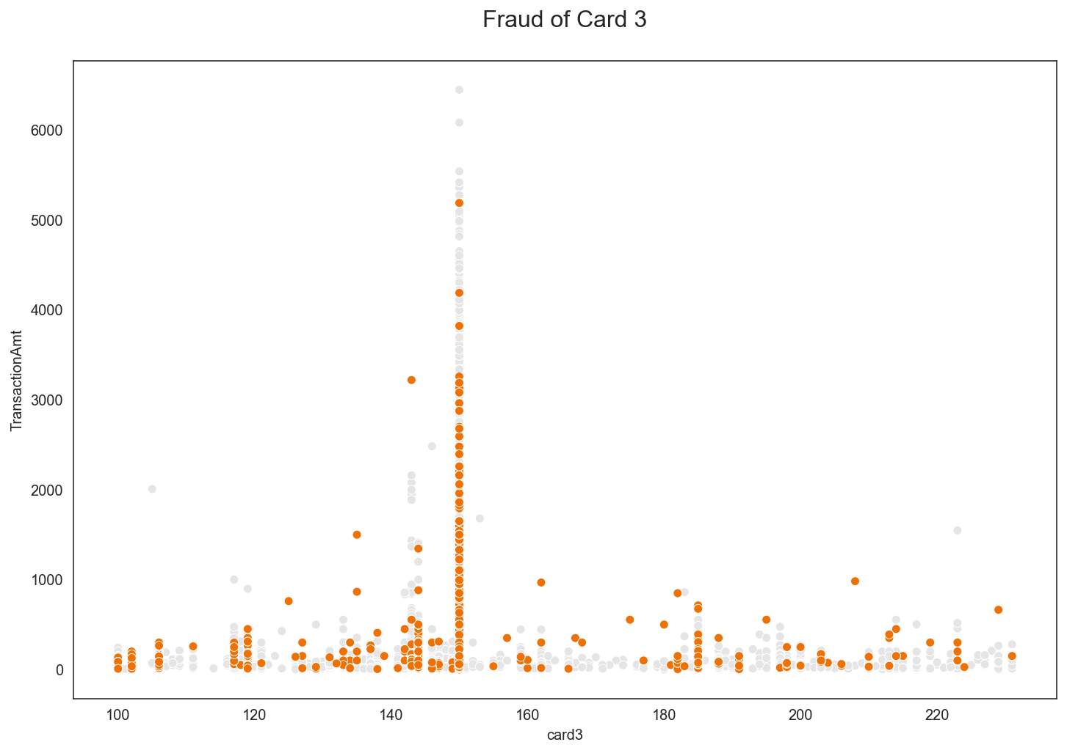
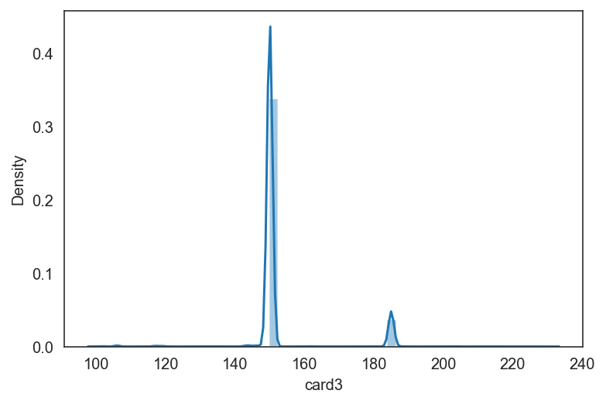
Explore the data (card 1-6)
Card 3

Slide 18
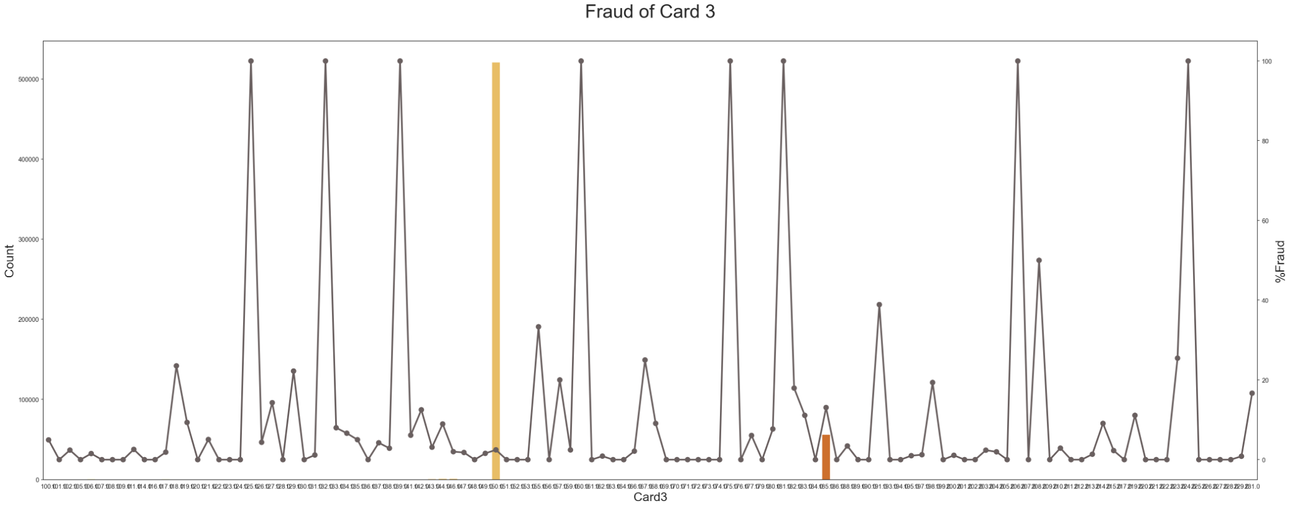
%Fraud of card 3

Slide 19
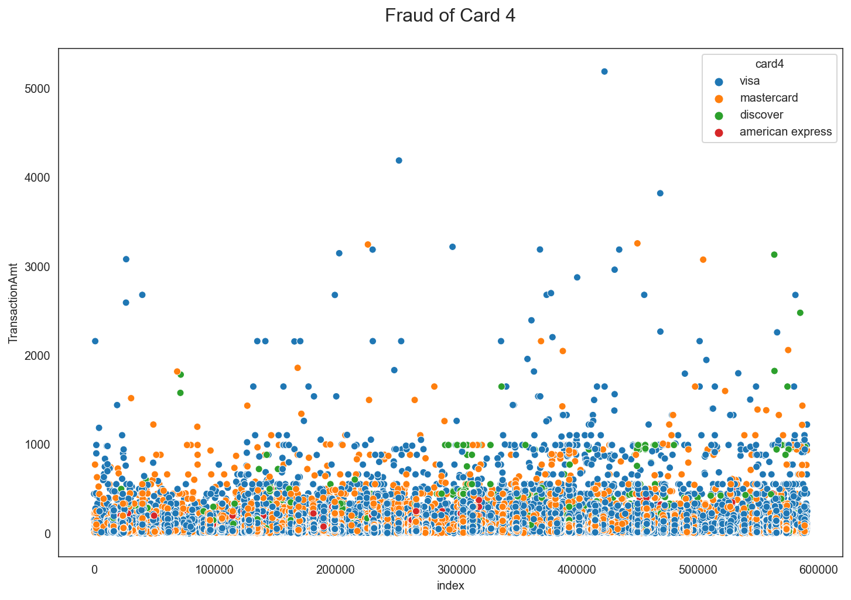
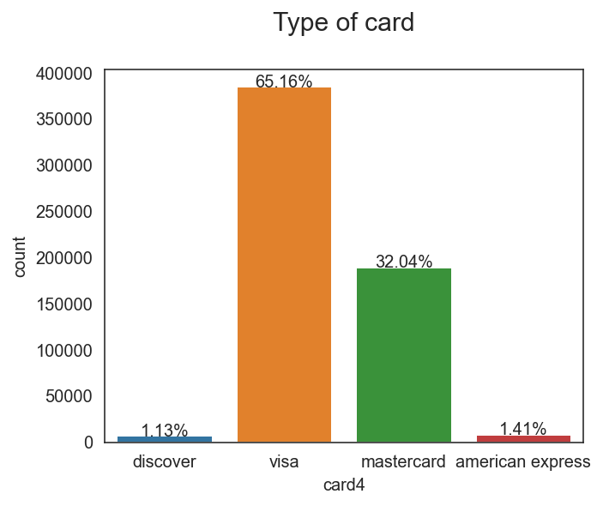
Explore the data (card 1-6)
Card 4
Total count of Card 4
Discover: 1.13%
Visa: 65.16%
Mastercard: 32.04%
American Express: 1.41%

Slide 20
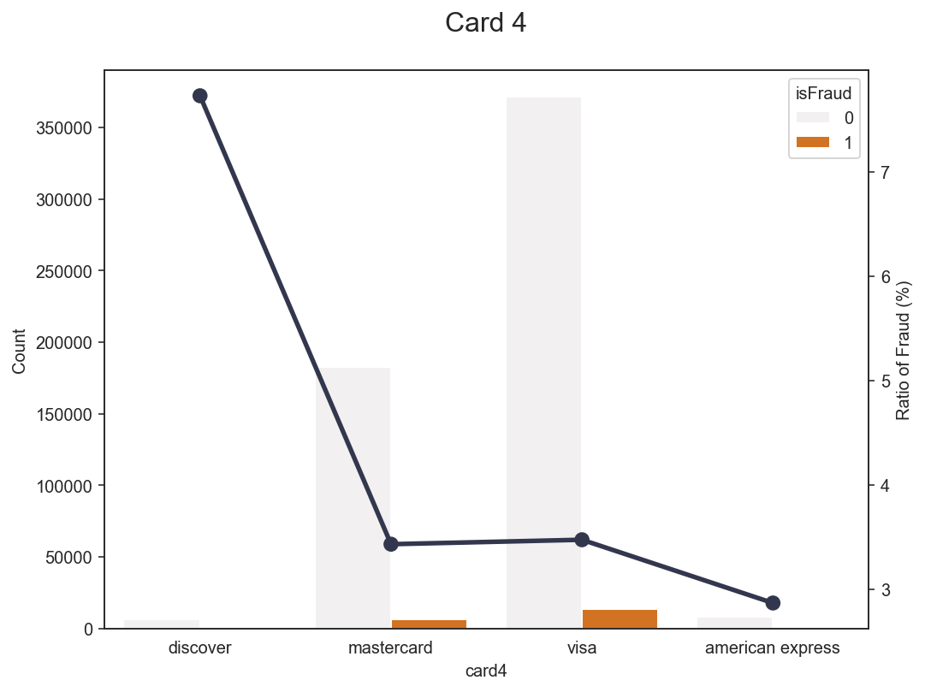
Explore the data (card 4)
Visa - Fraud: 3.48% - Not Fraud: 96.52%
Discover - Fraud: 7.73% - Not Fraud: 92.27%
Mastercard - Fraud: 3.43% - Not Fraud: 96.57%
AmericanExpress - Fraud: 2.87% - Not Fraud: 97.13%

Slide 21
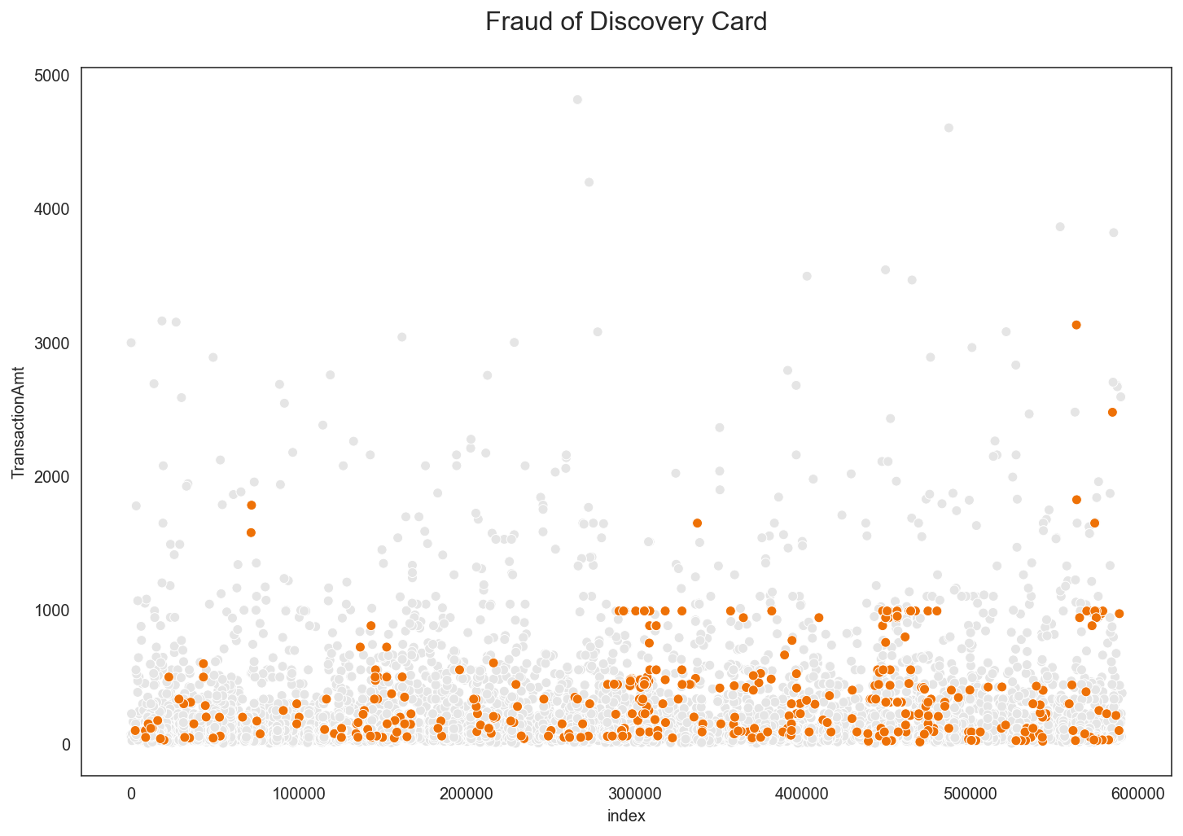
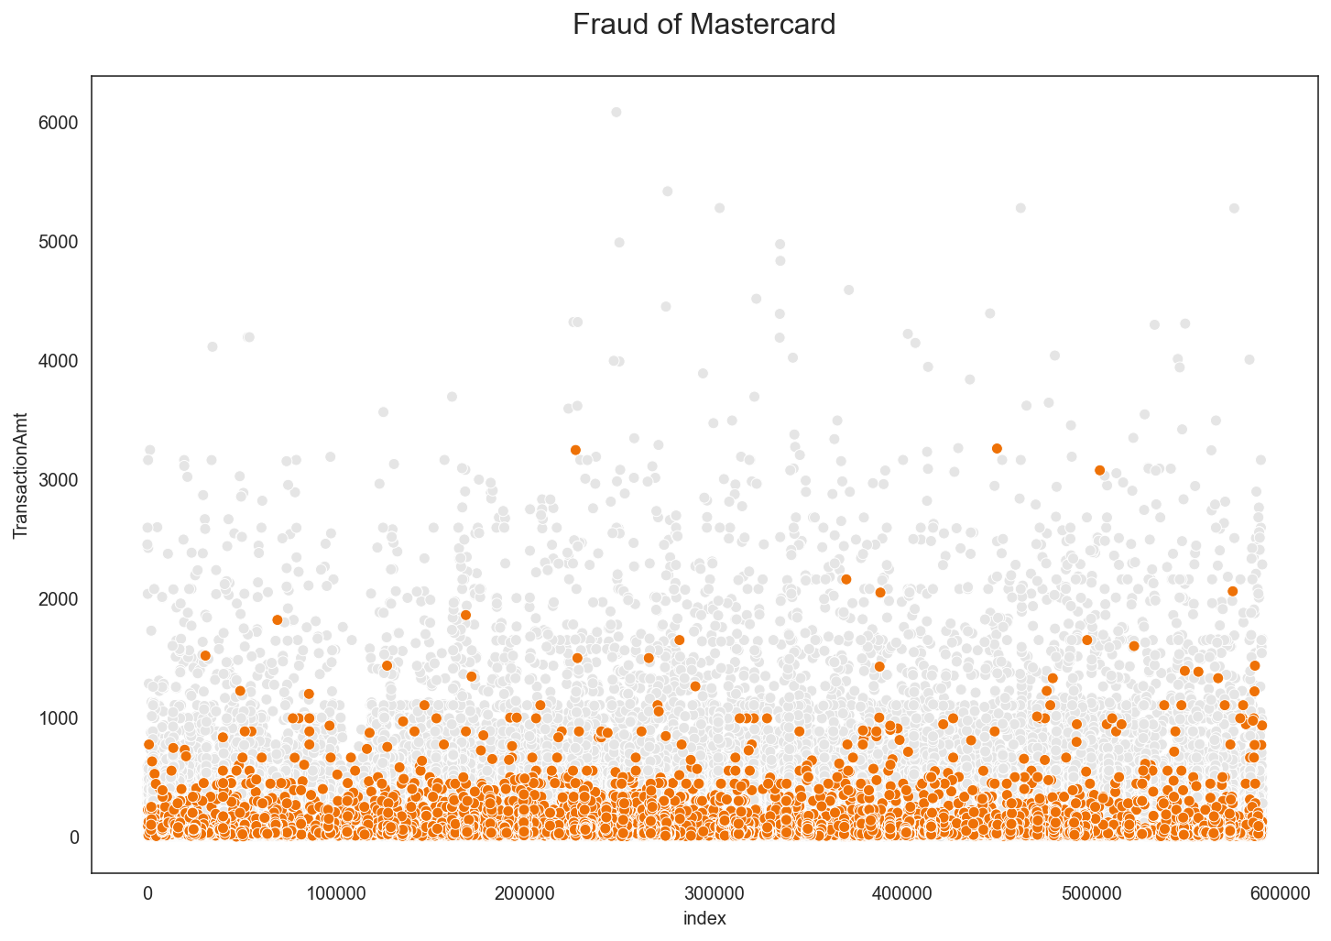
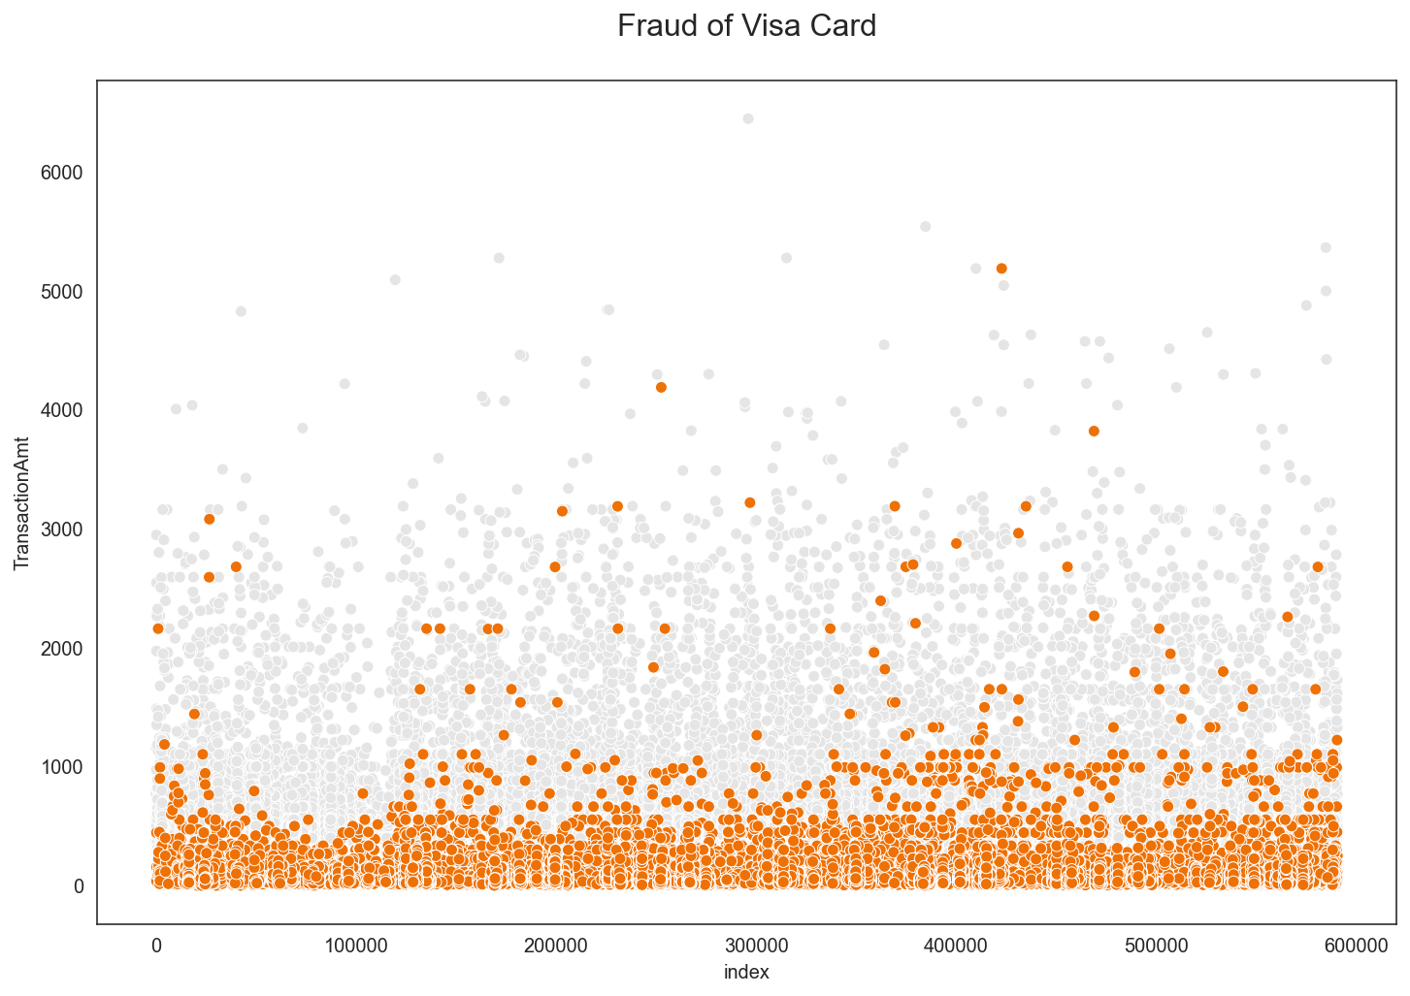
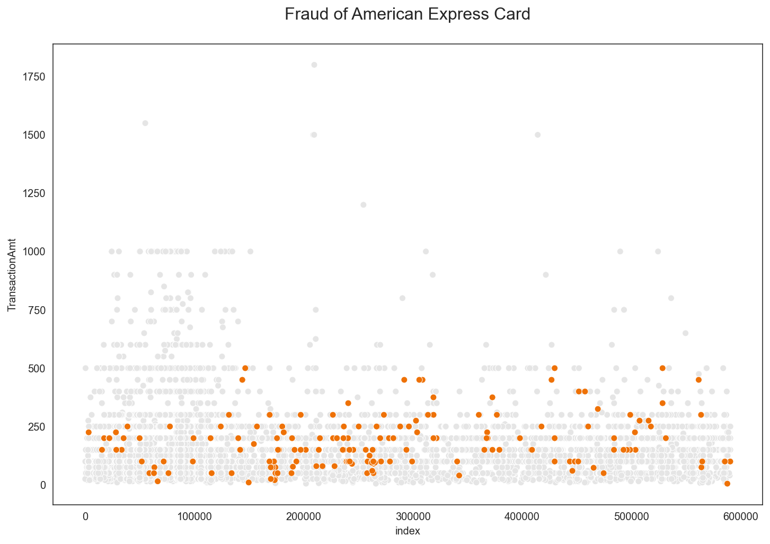

Slide 22
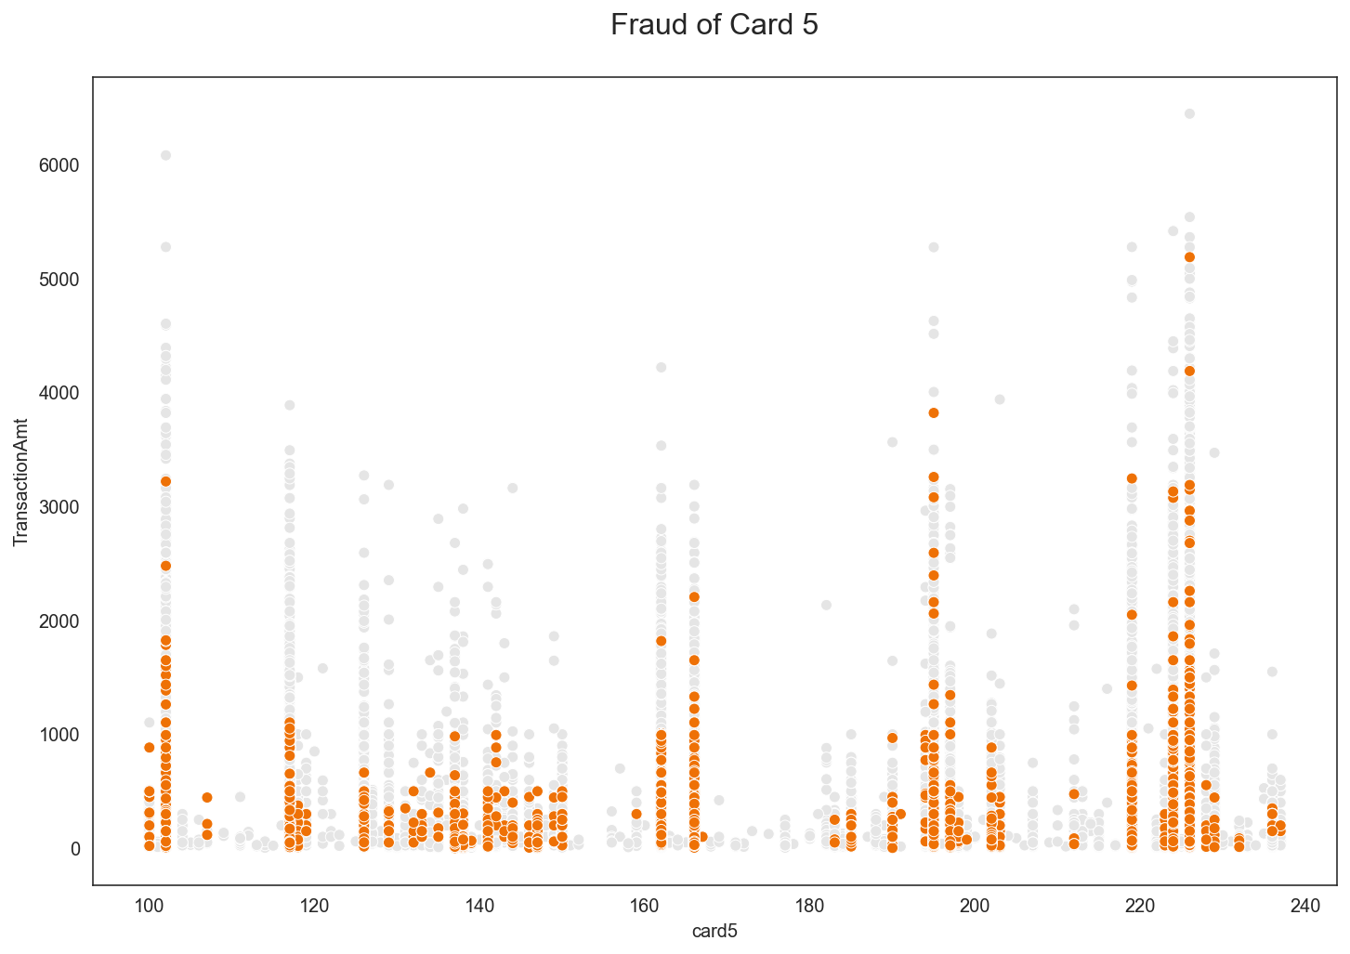
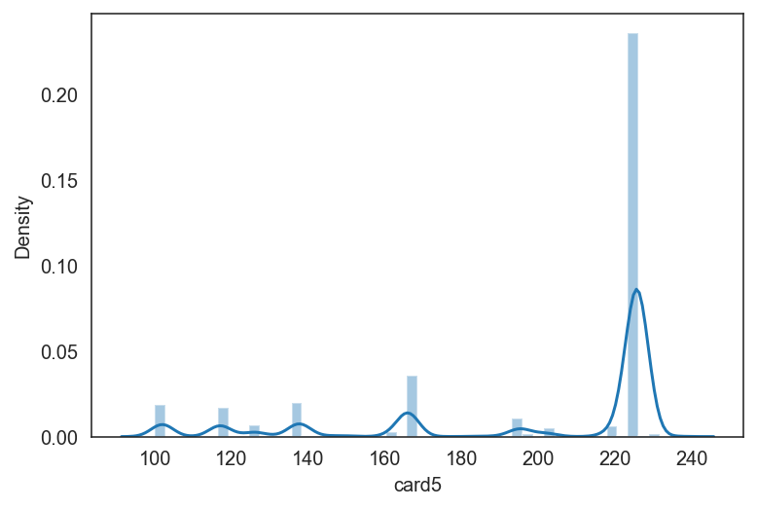
Explore the data (card 1-6)
Card 5

Slide 23
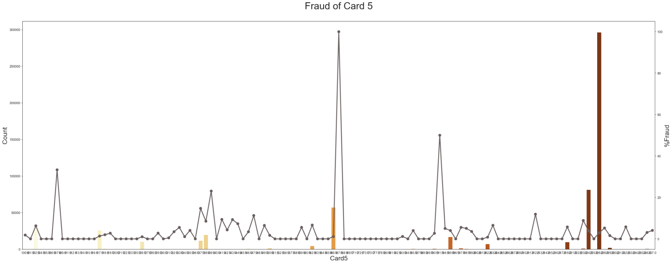
%Fraud of card 5

Slide 24
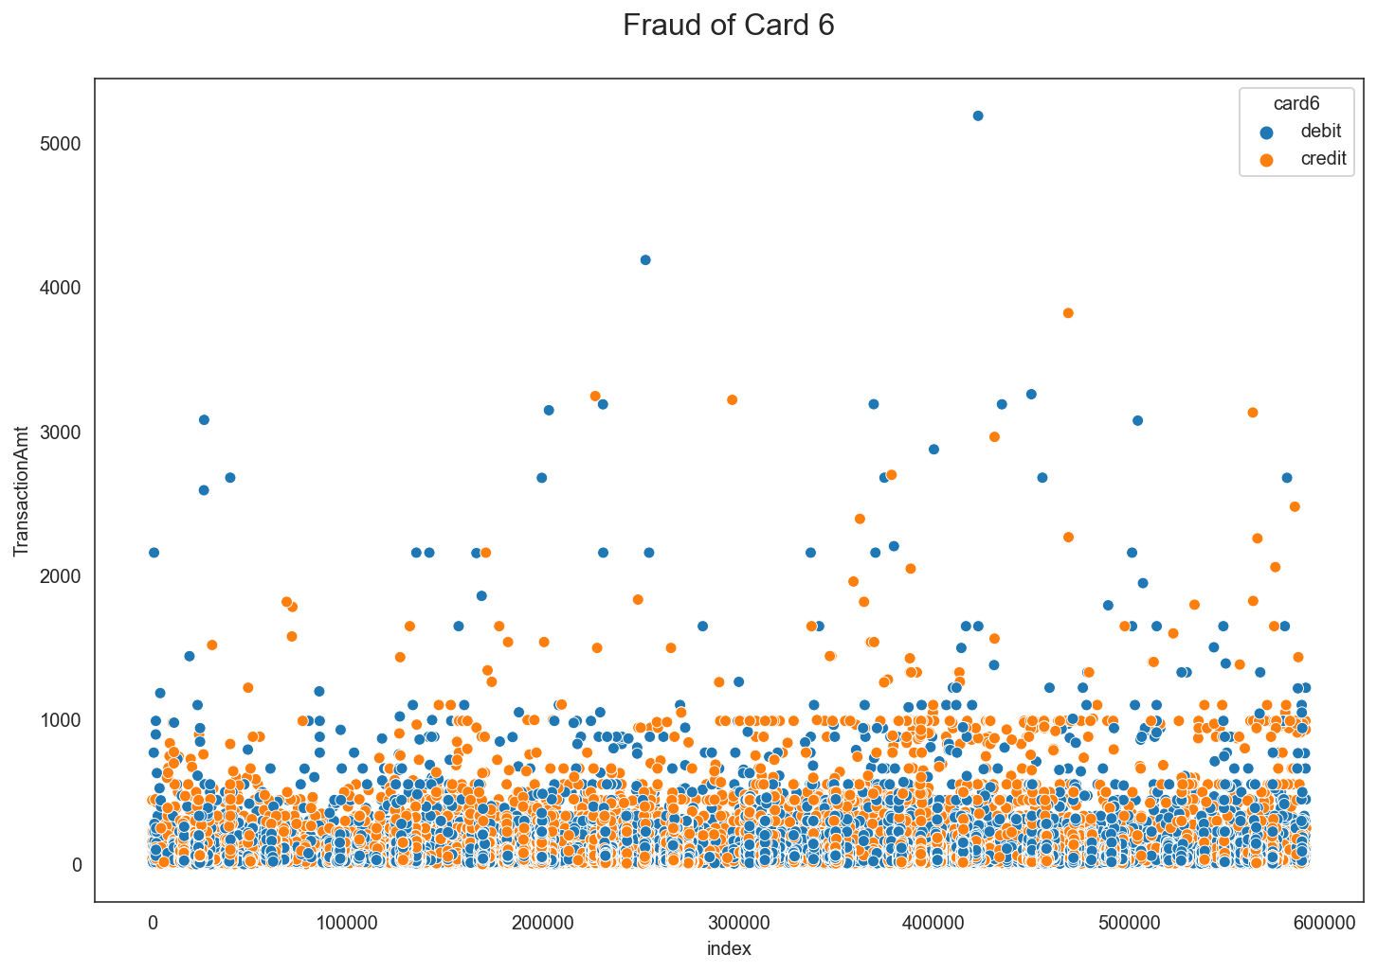
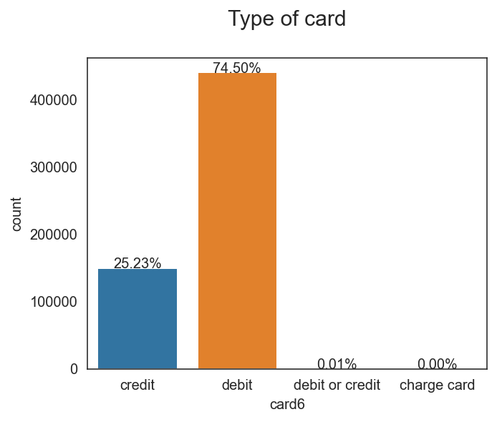
Explore the data (card 1-6)
Card 6
Total count of Card 6
Credit: 25.23%
Debit: 74.50%
Debit/Credit: 0.01%
Charge Card: 0.00%

Slide 25
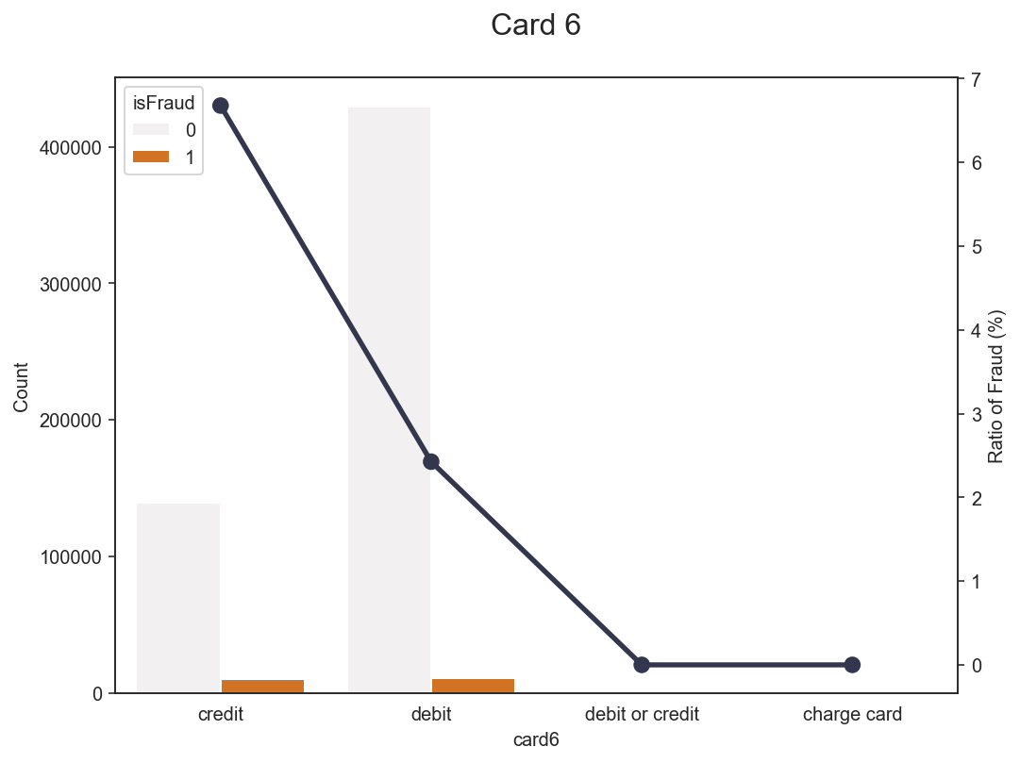
Explore the data (card 6)
Debit/Credit - Fraud: 2.43% - Not Fraud: 97.57%
Credit - Fraud: 6.68% - Not Fraud: 93.32%
Charge Card - Fraud: 0% - Not Fraud: 100%
Debit - Fraud: 2.43% - Not Fraud: 97.57%

Slide 26
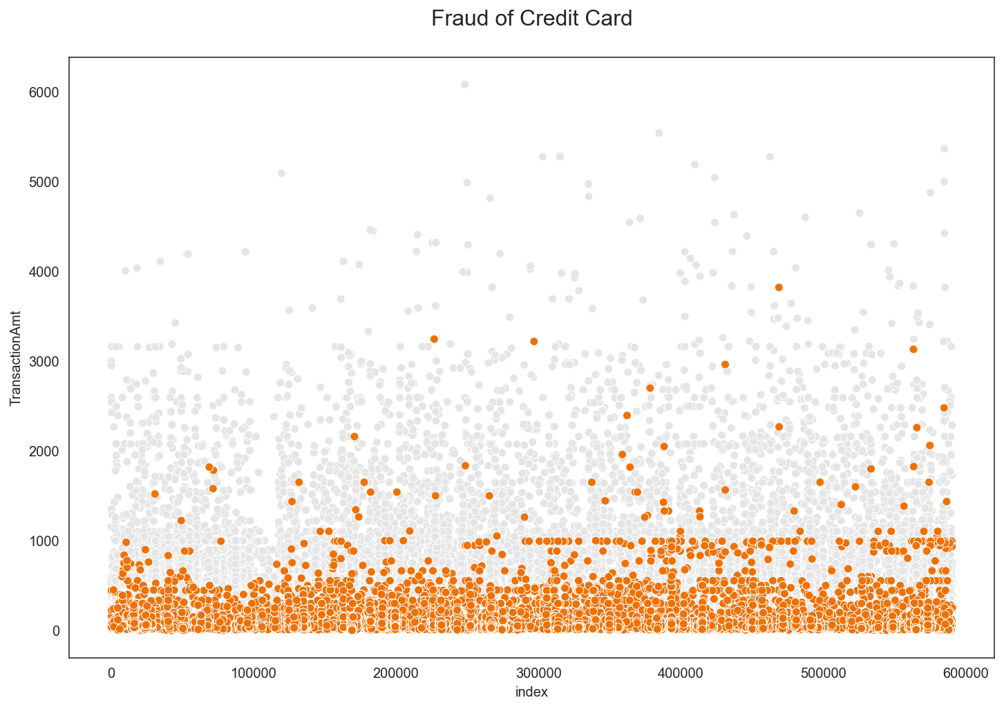

Slide 27
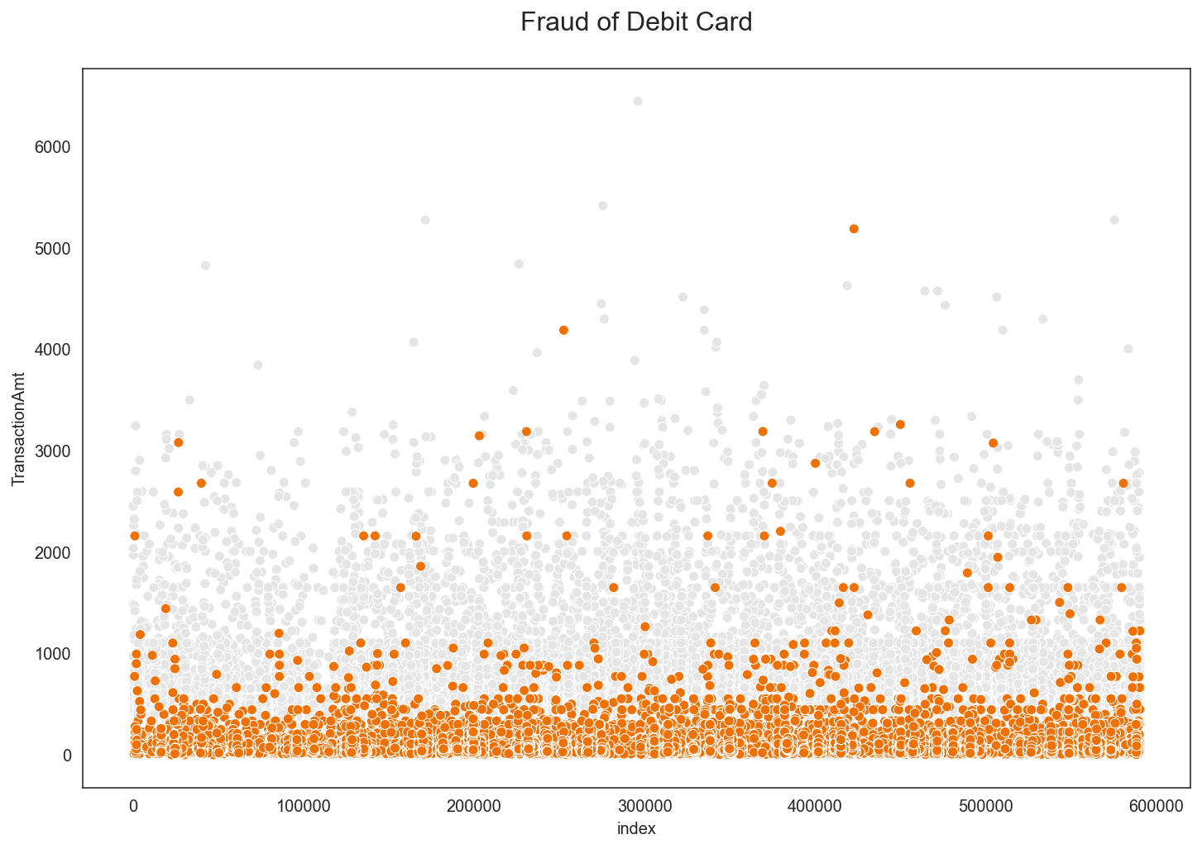

Slide 28
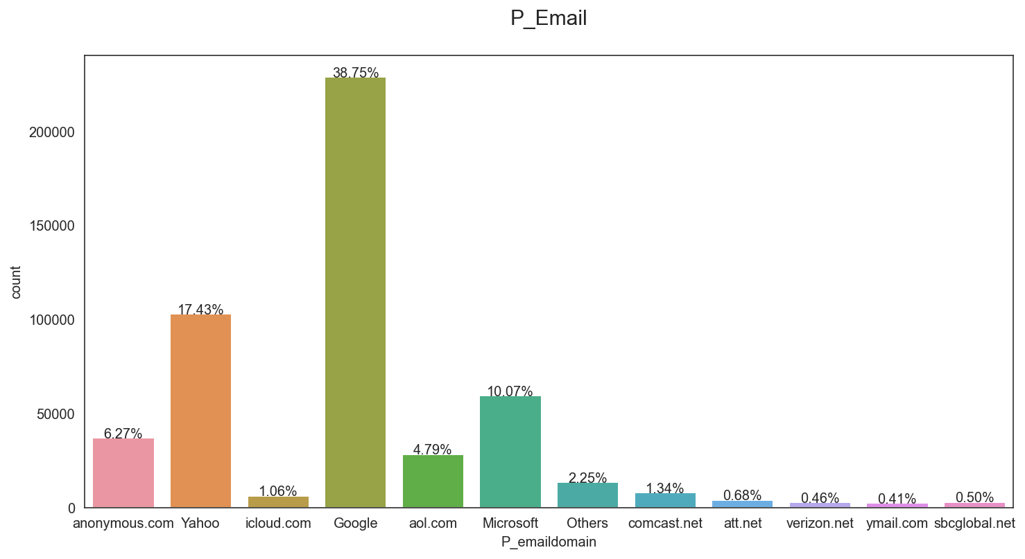
Explore the data (P_Email)
This graph is the ratio for each type of email. The popular email is ‘Google’.
There are 59 types of email. They are grouped into 4 groups are ‘Google’, ‘Yahoo’, ‘Microsoft’ and ‘Others’. ‘Others’ is the group of emails that has more than 2000 email’s customers.

Slide 29
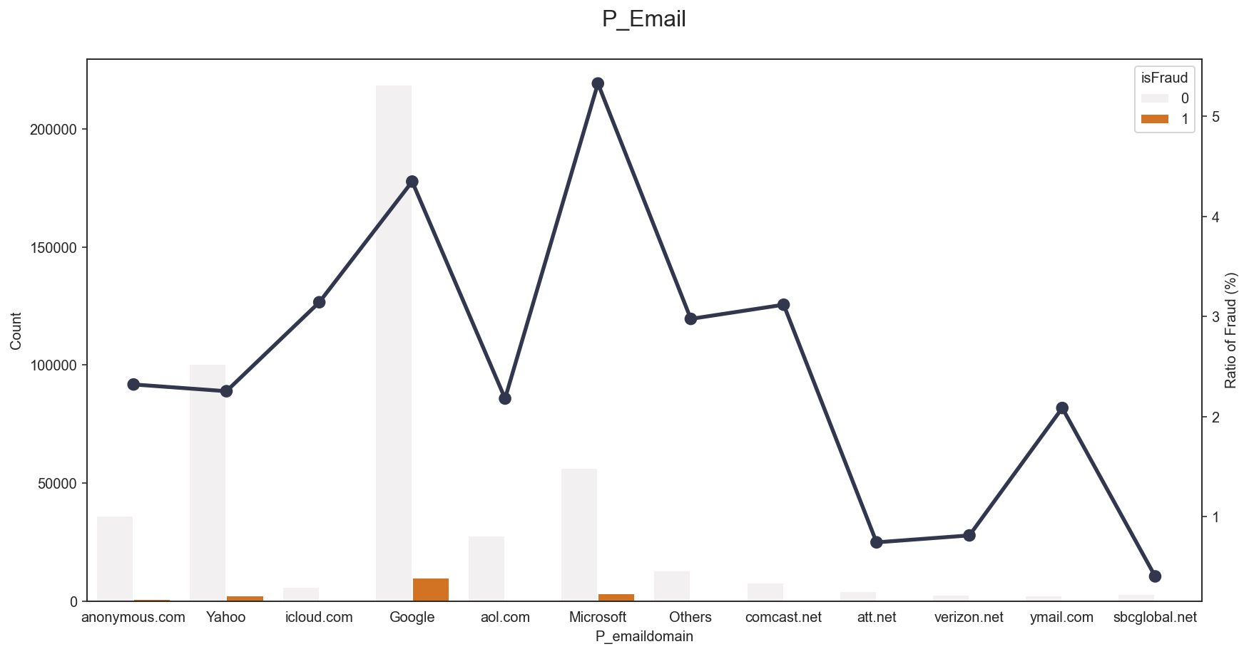
Explore the data (P_Email)
Google - Fraud: 4.35% - Not Fraud: 95.65%
Microsoft - Fraud: 5.33% - Not Fraud: 94.67%
Others - Fraud: 2.98% - Not Fraud: 97.02%
Yahoo - Fraud: 2.25% - Not Fraud: 97.02%

Slide 30
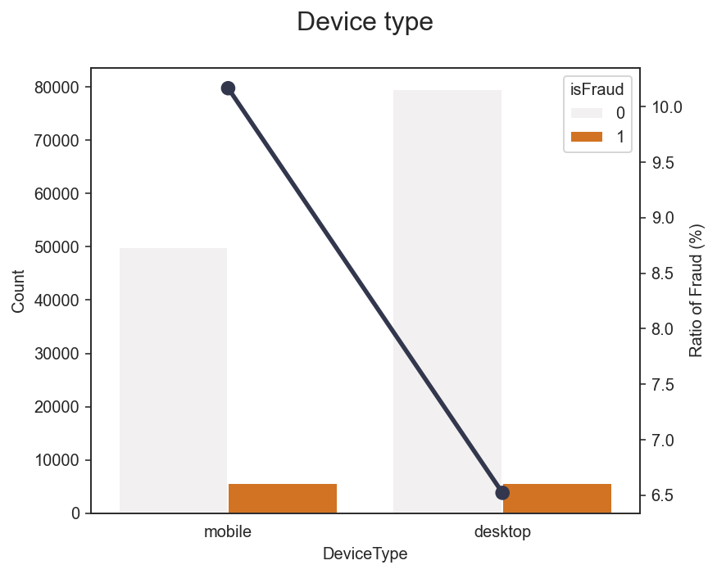
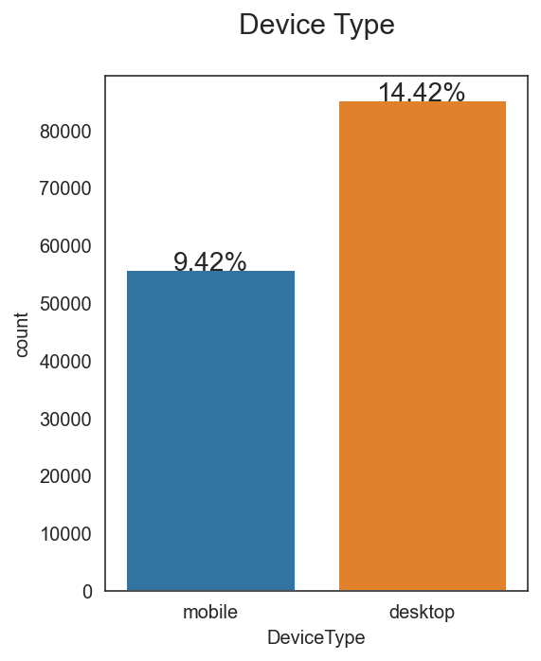
Explore the data (Device Type)
Total count of device type - Mobile: 9.42% - Desktop: 14.42% - Null value: 76.16%
Mobile - Fraud: 10.17% - Not Fraud: 89.83%
Desktop - Fraud: 6.52% - Not Fraud: 93.48%

Slide 31
02
Evaluation Models
Train size: 455,920
Validation size: 118,108
Test size: 506,691

Slide 32
Whoa!
We will find the probability of which customers are fraud by our models
Decision Tree
RandomForest
Gradient Boosting
AutoEncoder

Slide 33
Steps for prediction fraud
EDA & Cleaning the data by grouping the email, fill null value by mode and OneHotEncoding.
For Unsupervised Method (AutoEncoder), it predicts in the term of MSE.
Summary and comparison the models.
Step 1
Step 3
Step 5
Step 2
Step 4
For Supervised Method (DecisionTree or RandomForest), using SMOTE for solving the imbalance data of training set
Evaluate models by ROC curve, AUC score, accuracy, precision, recall, misclassification and specificity

Slide 34
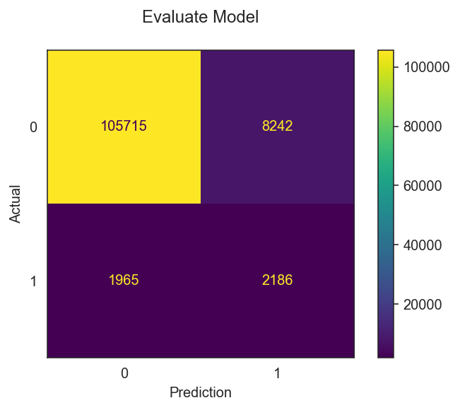
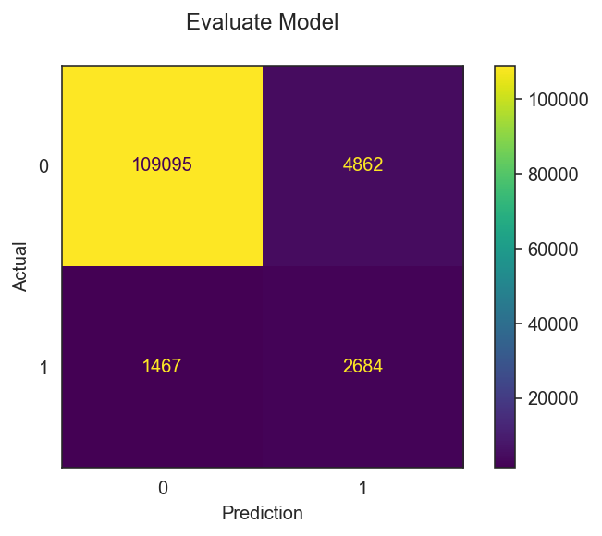
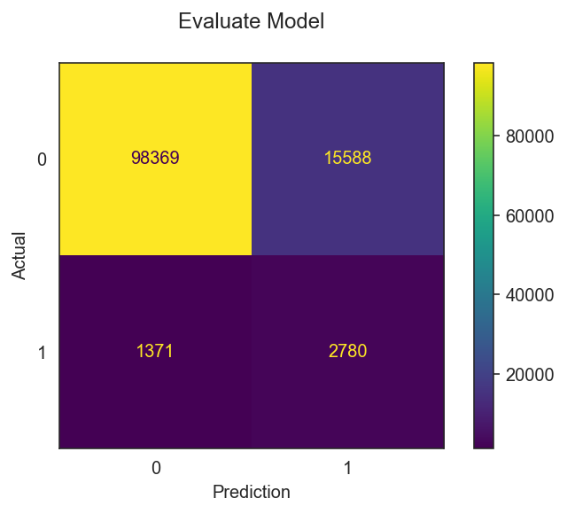
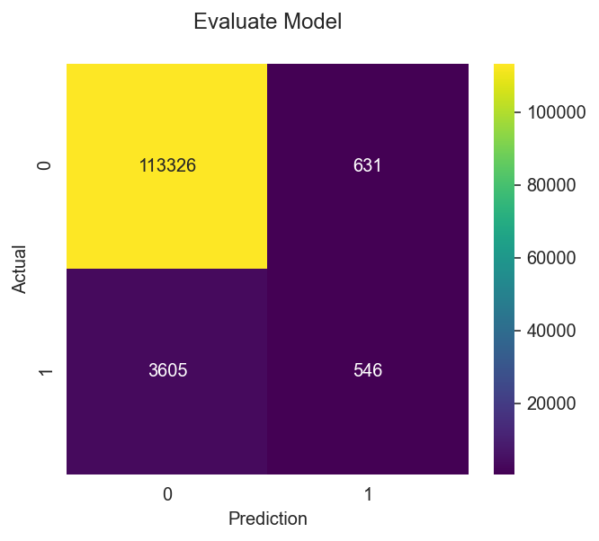
Confusion Matrix
DecisionTree
RandomForest
- TP = 2,186 - TN = 105,715 - FP = 2,186 - FN = 1,965 - Accuracy: 91.36% - Misclassification: 8.64% - Precision: 20.96% - Recall: 52.66% - Specificity: 92.77%
- TP = 2,684 - TN = 109,095 - FP = 4,862 - FN = 1,467 - Accuracy: 94.64% - Misclassification: 5.36% - Precision: 35.57% - Recall: 64.66% - Specificity: 95.73%
GradientBoosting
AutoEncoder (Threshold = 99.0%)
- TP = 2,780 - TN = 98,369 - FP = 15,588 - FN = 1,371 - Accuracy: 85.64% - Misclassification: 14.4% - Precision: 15.14% - Recall: 66.97% - Specificity: 86.32%
- TP = 546 - TN = 113,326 - FP = 631 - FN = 3,605 - Accuracy: 96.41% - Misclassification: 3.59% - Precision: 46.39% - Recall: 13.15% - Specificity: 99.45%

Slide 35
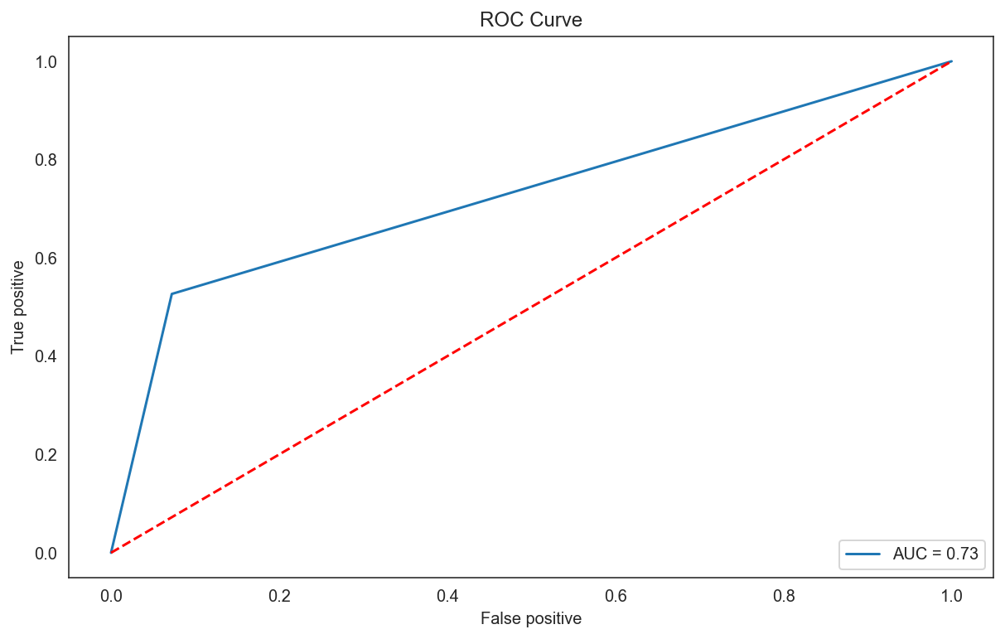
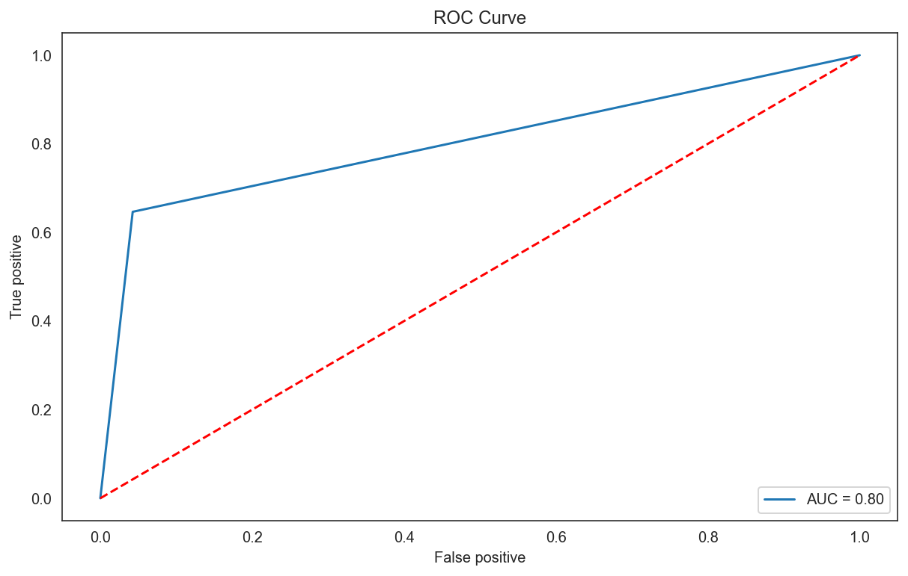
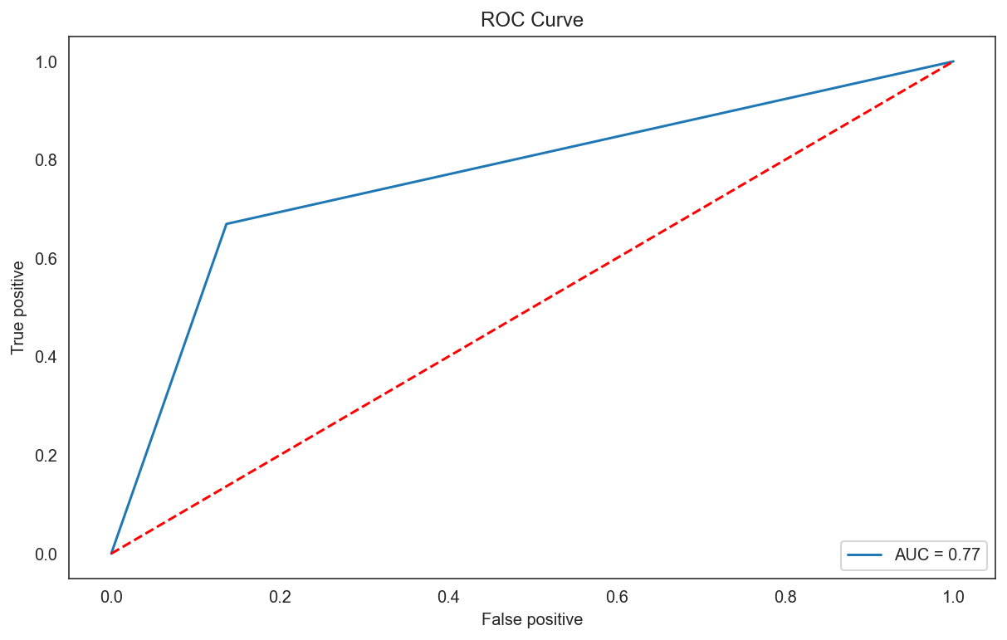
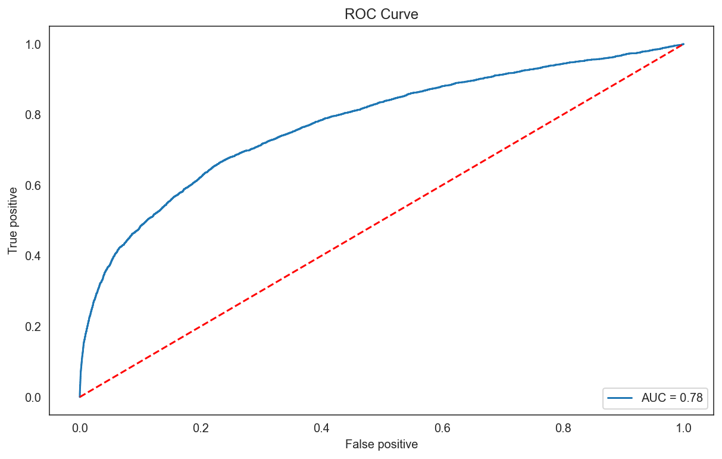
ROC Curve
DecisionTree
RandomForest
Gradient Boosting
AutoEncoder

Slide 36
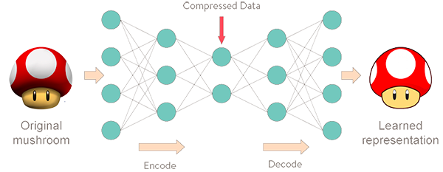
Auto Encoder
Autoencoders are a specific type of feedforward neural networks where the input is the same as the output. They compress the input into a lower-dimensional code and then reconstruct the output from this representation.

Slide 37
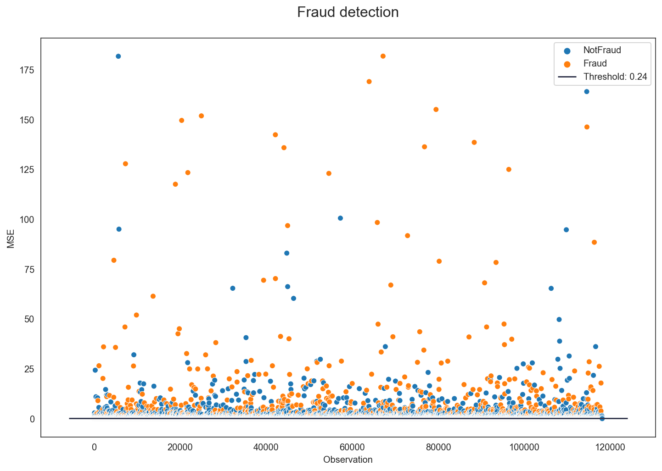
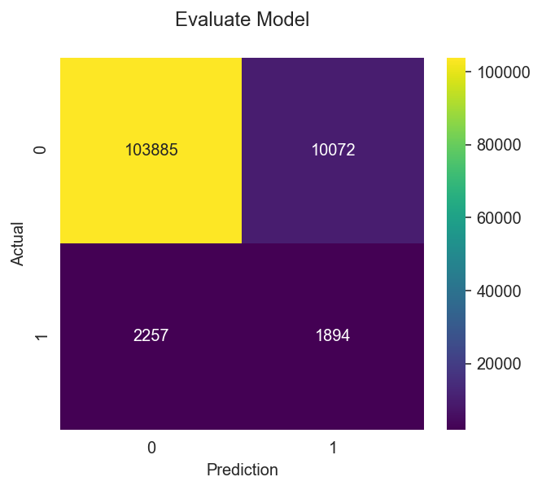
Adjust Threshold (Auto ENcoder)
Threshold = Percentile 90
TP
FP
- TP = 1,894 - TN = 103,885 - FP = 10,072 - FN = 2,257 - Accuracy: 89.56% - Misclassification: 10.44% - Precision: 15.83% - Recall: 45.63% - Specificity: 91.16%

Slide 38

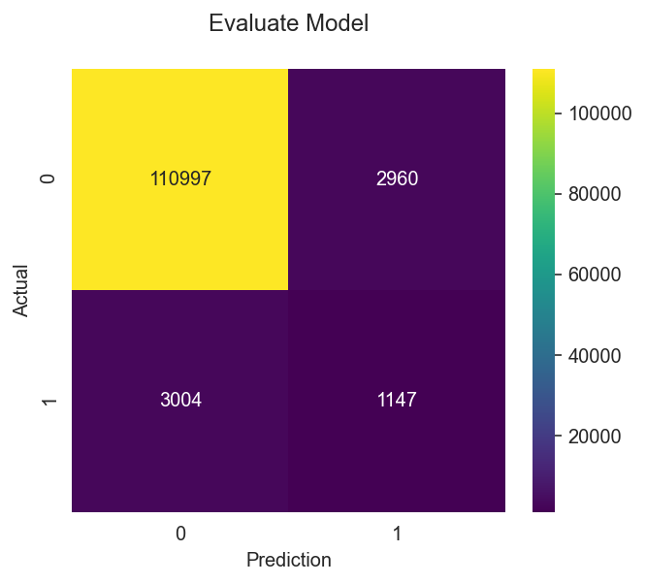
Adjust Threshold (Auto ENcoder)
Threshold = Percentile 96.5
TP
FP
- TP = 1,147 - TN = 110,997 - FP = 2,960 - FN = 3,004 - Accuracy: 94.95% - Misclassification: 5.05% - Precision: 27.93% - Recall: 27.63% - Specificity: 97.40%

Slide 39
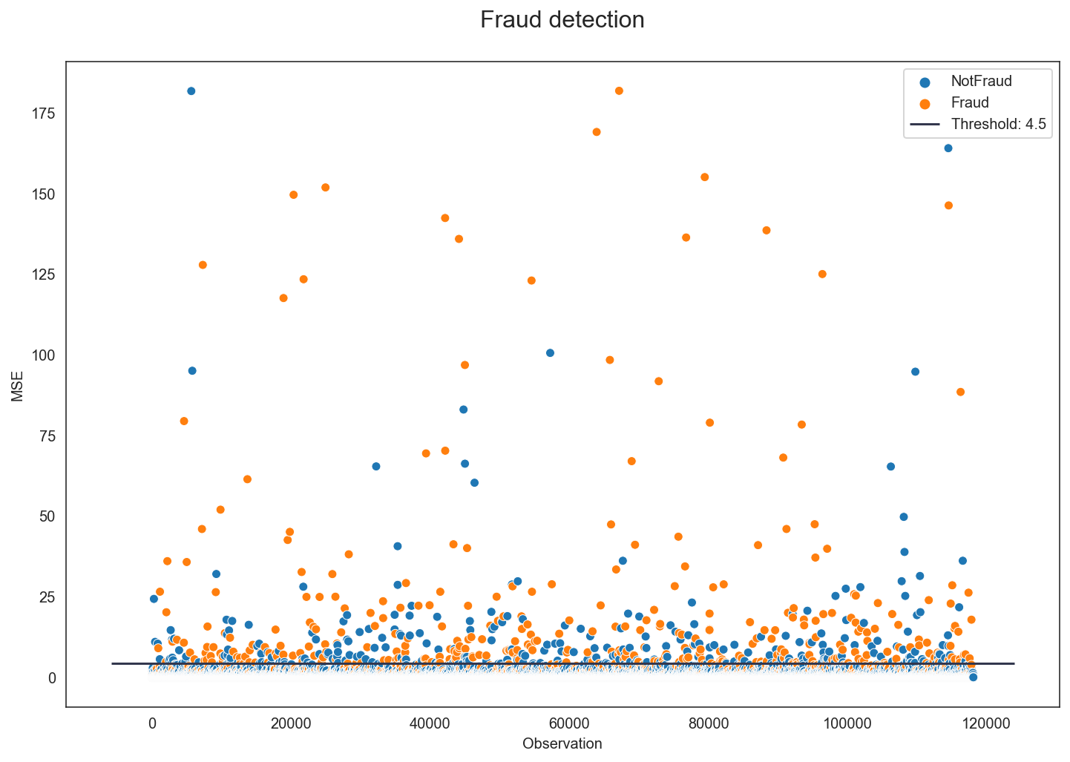

Adjust Threshold (Auto ENcoder)
Threshold = Percentile 99.5
TP
FP
- TP = 332 - TN = 113,698 - FP = 259 - FN = 3,819 - Accuracy: 96.55% - Misclassification: 3.45% - Precision: 56.18% - Recall: 8.00% - Specificity: 99.77%

Slide 40
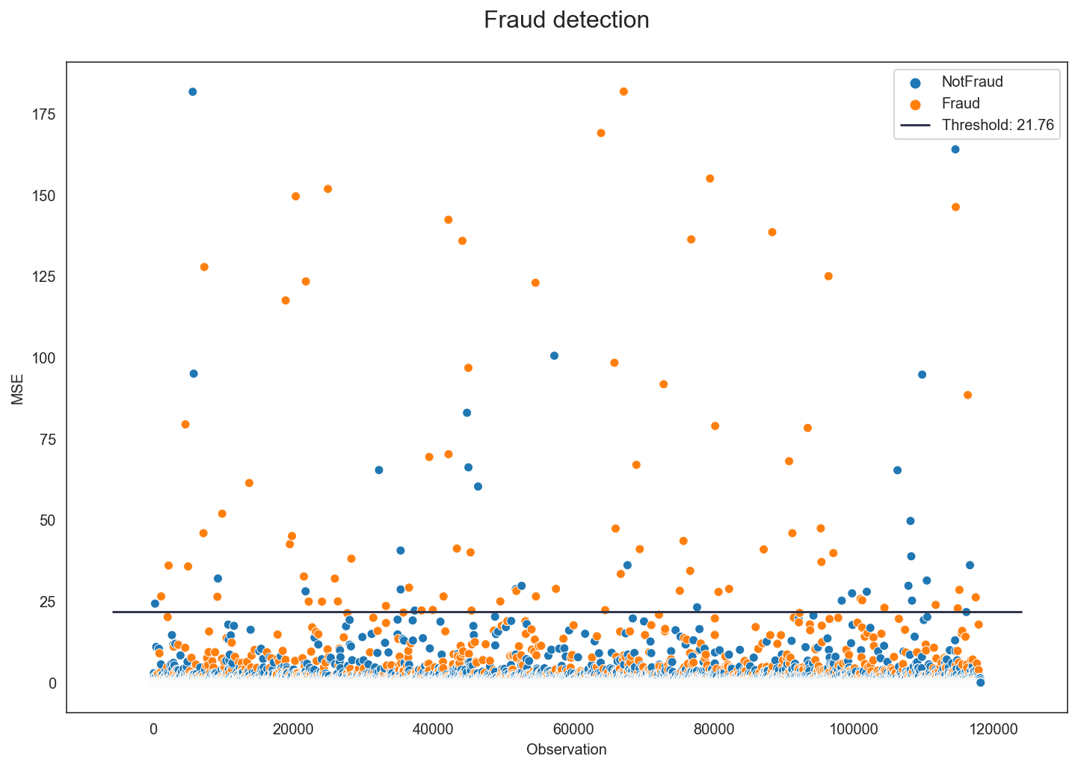

Adjust Threshold (Auto ENcoder)
Threshold = Percentile 99.9
TP
FP
- TP = 82 - TN = 113,920 - FP = 37 - FN = 4,069 - Accuracy: 96.52% - Misclassification: 3.48% - Precision: 68.91% - Recall: 1.98% - Specificity: 99.97%
FN
TN

Slide 41
Result from evaluation model
Model | TP | TN | FP | FN | Accuracy | Misclassification | Precision | Recall | Specificity
AutoEncoder
Thres 90.0% | 1,894 | 103,885 | 10,072 | 2,257 | 89.56% | 10.44% | 15.83% | 45.63% | 91.16%
Thres 96.5% | 1,147 | 110,997 | 2,960 | 3,004 | 94.95% | 5.05% | 27.93% | 27.63% | 97.40%
Thres 99.0% | 546 | 113,326 | 631 | 3,605 | 96.41% | 3.59% | 46.39% | 13.15% | 99.45%
Thres 99.5% | 332 | 113,698 | 259 | 3,819 | 96.55% | 3.45% | 56.18% | 8.00% | 99.77%
Thres 99.9% | 82 | 113,920 | 37 | 4,069 | 96.52% | 3.48% | 68.91% | 1.98% | 99.97%
Decision Tree | 2,186 | 105,715 | 2,186 | 1,965 | 91.36% | 8.64% | 20.96% | 52.66% | 92.77%
Random Forest | 2,684 | 109,095 | 4,862 | 1,467 | 94.64% | 5.36% | 35.57% | 64.66% | 95.73%
Gradient Boosting | 2,780 | 98,369 | 15,588 | 1,371 | 85.64% | 14.4% | 15.14% | 66.97% | 86.32%

Slide 42
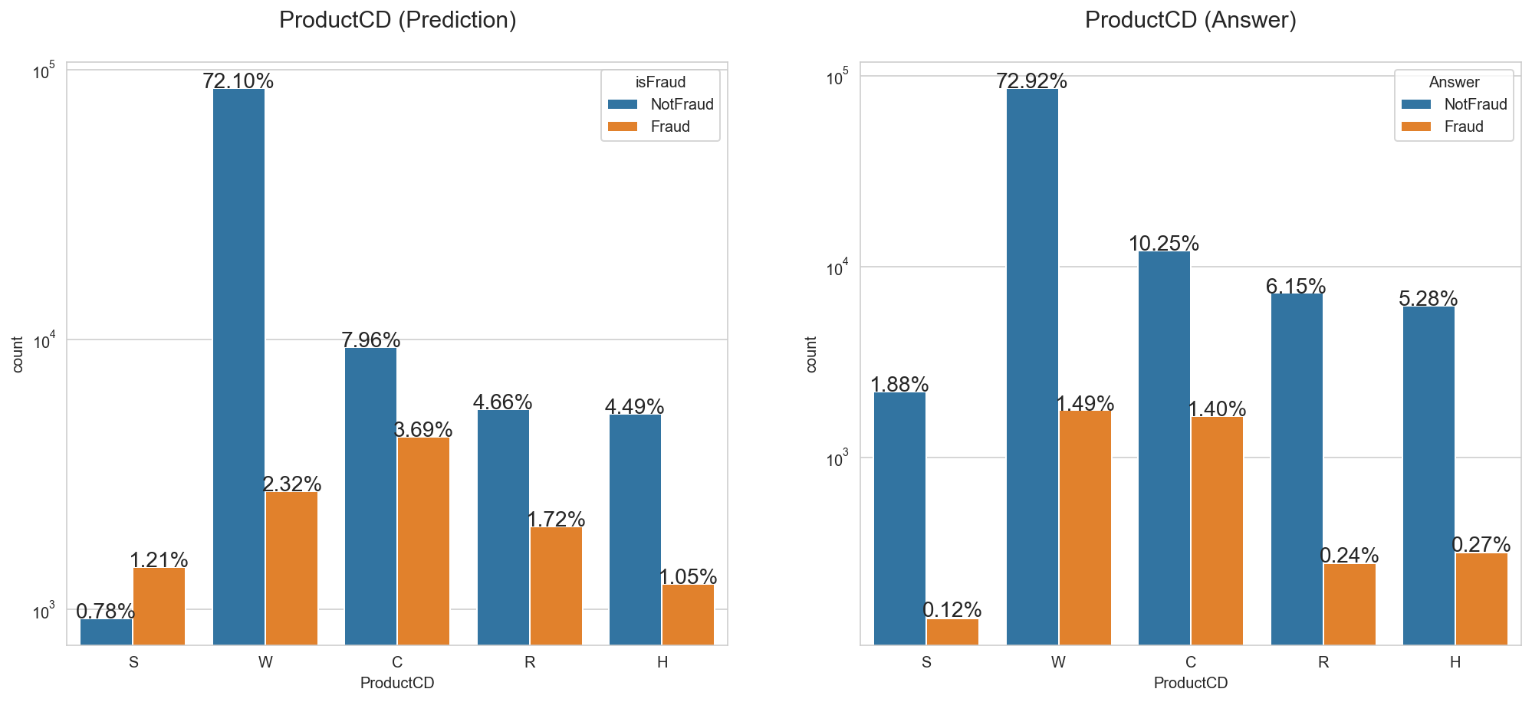
Prediction vs Answer (Auto Encoder)
Threshold = Percentile 90

Slide 43
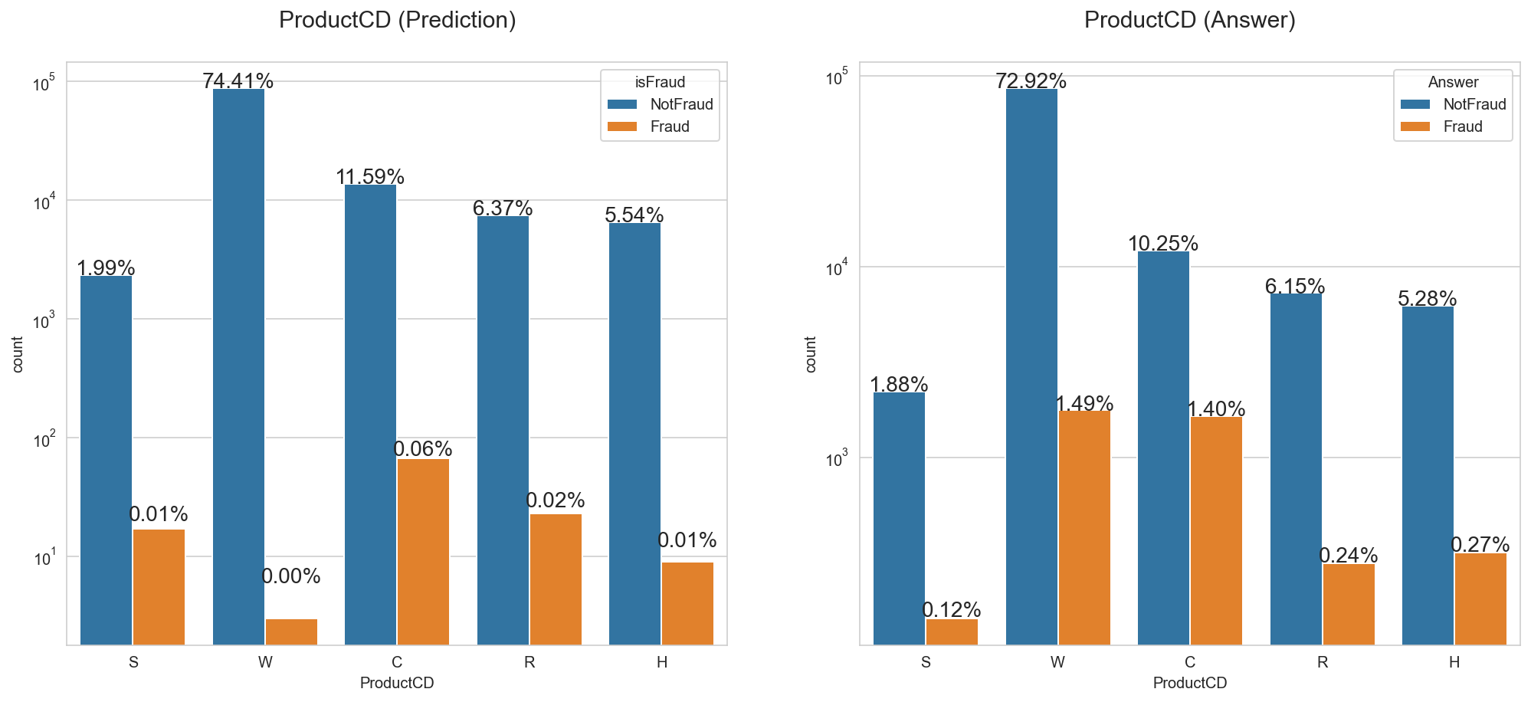
Prediction vs Answer (Auto Encoder)
Threshold = Percentile 99.9

Slide 44
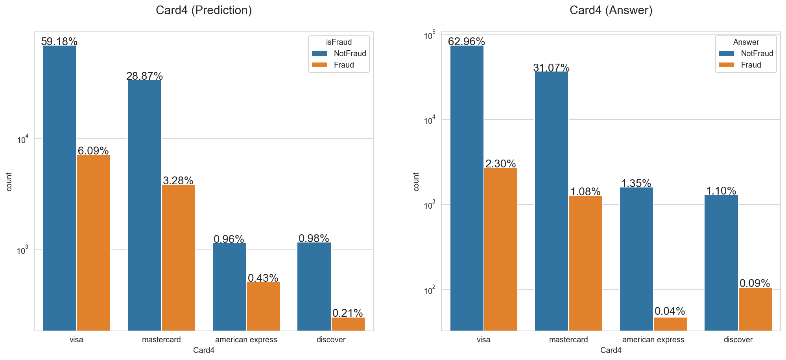
Prediction vs Answer (Auto Encoder)
Threshold = Percentile 90

Slide 45

Prediction vs Answer (Auto Encoder)
Threshold = Percentile 99.9

Slide 46
Testing in Kaggle
Comparison 4 models with test score in Kaggle
DecisionTree Test Score: 69.26%
RandomForest Test Score: 88.79%
GradientBoosting Test Score: 88.90%
AutoEncoder Test Score: 78.23%

Slide 47
Conclusion
Fraudulent transactions spend a little money but many times.
The transaction with product C, Discovery card, credit card, Microsoft email and use a mobile have more chance to be a fraudulent transactions.
The best model to predict probability of fraud or not fraud for this data set is Gradient Boosting.
Each company has the different criteria to detect fraud so, we can adjust the suitable threshold from the model’s prediction.

Slide 48
Thanks!
Do you have any questions?

